Slide 1


Jingze Dai
August 1, 2023

Slide 2

Outline
Executive Summary
Introduction
Methodology
Results
Conclusion
Appendix

Slide 3
Executive Summary
Summary of methodologies
Data Collections (with SpaceX API, web scraping, and data wrangling)
Data Analysis (Exploratory Data Analysis, with SQL)
Data Visualization (Visualize Data and Data Results)
Machine Learning Prediction
Summary of all results
Successfully getting data from data collections
In the data analysis (EDA), successfully getting all desired results
Machine learning tools give a good prediction on given data

Slide 4
Introduction
Project background and context
SpaceX is one of the top commercial space company. There is a difference between costs: SpaceX says a falcon 9’s landing requires 62 million dollars, while others have a figure: up to 165 million dollars. The first figure is much lower is because, SpaceX reuses its launching and landing facilities. We can determine if
Problems you want to find answers
What are differences between successful and unsuccessful landings? (In details)
What are overall trends of successful landing probability on different types of launchings?
What are relationships between landing results and different factors?

Slide 5

Section 1

Slide 6
Methodology
Executive Summary
Data collection methodology:
SpaceX API
Web Scraping
Perform data wrangling
Delete unnecessary columns
Adding default values to missing values
Perform exploratory data analysis (EDA) using visualization and SQL
Perform interactive visual analytics using Folium and Plotly Dash
Perform predictive analysis using classification models
Use exploratory data analysis with SQL usages, as well as data visualization

Slide 7
Data Collection
Describe how data sets were collected.
Method 1: SpaceX API
https://api.spacexdata.com/v4/rockets/
Method 2: Web scraping
https://en.wikipedia.org/w/index.php?title=List_of_Falcon_9_and_Falcon_Heavy_launches&oldid=1027686922

Slide 8
Data Collection – SpaceX API
https://github.com/daijingz/Data-Science-Machine-Learning/blob/main/Coursera%20Capstone/Data%20Collection%20API.ipynb
Part 1: Requesting data
spacex_url="https://api.spacexdata.com/v4/launches/past"
response = requests.get(spacex_url)
Part 2: Data Normalization
Part 3: Solving the missing-value problem
Part 4: Extract columns by requirements
In this project there is an example: extract only “Falcon 9” columns

Slide 9
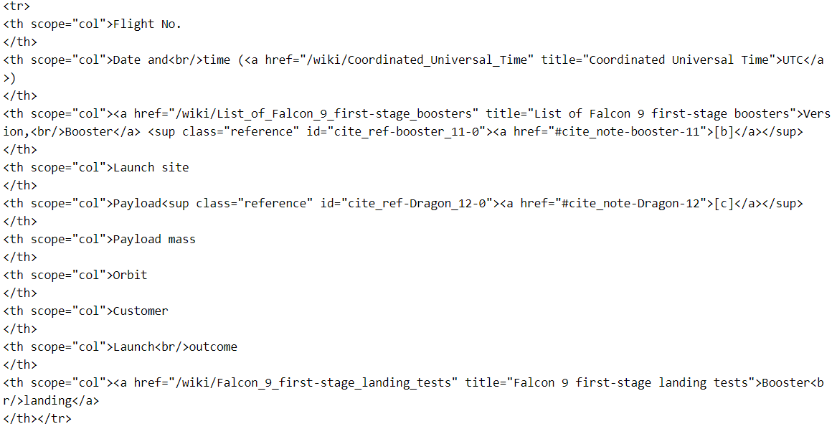
Data Collection - Scraping
Part 1: Request the Falcon9 Launch Wiki page from its URL
Part 2: Extract all column/variable names from the HTML table header
Part 3: Create a data frame by parsing the launch HTML tables
Successful Results:
https://github.com/daijingz/Data-Science-Machine-Learning/blob/main/Coursera%20Capstone/Data%20Collection%20API%20with%20Webscraping.ipynb

Slide 10
Data Wrangling
In the data set, there are several different cases where the booster did not land successfully. Sometimes a landing was attempted but failed due to an accident; for example, True Ocean means the mission outcome was successfully landed to a specific region of the ocean while False Ocean means the mission outcome was unsuccessfully landed to a specific region of the ocean. True RTLS means the mission outcome was successfully landed to a ground pad False RTLS means the mission outcome was unsuccessfully landed to a ground pad. True ASDS means the mission outcome was successfully landed on a drone ship False ASDS means the mission outcome was unsuccessfully landed on a drone ship.
In this lab we will mainly convert those outcomes into Training Labels with 1 means the booster successfully landed 0 means it was unsuccessful.
https://github.com/daijingz/Data-Science-Machine-Learning/blob/main/Coursera%20Capstone/Data%20Wrangling.ipynb

Slide 11
EDA with Data Visualization
There are three kinds of charts (diagrams) used:
Scatter Graphs (e.g., flight number AND payload mass)
Bar Graph (e.g., successful rate AND orbits)
Line Graph (e.g., successful rate AND year)
https://github.com/daijingz/Data-Science-Machine-Learning/blob/main/Coursera%20Capstone/Exploratory%20Data%20Analysis%20for%20Data%20Visualization.ipynb

Slide 12
EDA with SQL
Completed tasks:
Display the names of the unique launch sites in the space mission
Display 5 records where launch sites begin with the string 'CCA’
Display the total payload mass carried by boosters launched by NASA (CRS)
Display average payload mass carried by booster version F9 v1.1
List the date when the first successful landing outcome in ground pad was acheived.
List the names of the boosters which have success in drone ship and have payload mass greater than 4000 but less than 6000
Other tasks in the notebook below ->
https://github.com/daijingz/Data-Science-Machine-Learning/blob/main/Coursera%20Capstone/Exploratory%20Data%20Analysis%20using%20SQL.ipynb

Slide 13
Build an Interactive Map with Folium
The launch success rate may depend on many factors such as payload mass, orbit type, and so on. It may also depend on the location and proximities of a launch site, i.e., the initial position of rocket trajectories. Finding an optimal location for building a launch site certainly involves many factors and hopefully we could discover some of the factors by analyzing the existing launch site locations.
TASK 1: Mark all launch sites on a map
TASK 2: Mark the success/failed launches for each site on the map
TASK 3: Calculate the distances between a launch site to its proximities
http://localhost:8888/notebooks/Desktop/Coursera%20IBM%20Data%20Science%20Capstone%20Projects/Interactive%20Visual%20Analytics%20with%20Folium%20lab.ipynb

Slide 14
Build a Dashboard with Plotly Dash
There are 10 visualized plots (diagrams) added, and from these plots, we can have a clearer view of relations between payloads and launch sites.
https://github.com/daijingz/Data-Science-Machine-Learning/blob/main/Coursera%20Capstone/spacex_dash_app.py

Slide 15
Predictive Analysis (Classification)
Task 1: data preparation
Task 2: Data standardization
Task 3: Training
Task 4: Testing
Task 5: Comparison results
https://github.com/daijingz/Data-Science-Machine-Learning/blob/main/Coursera%20Capstone/Machine%20Learning%20Prediction.ipynb

Slide 16
Results
Exploratory data analysis results (Successful, please see my notebook)
Interactive analytics demo in screenshots (Successful, please see my notebook)
Predictive analysis results (Successful, please see my notebook)

Slide 17

Section 2

Slide 18
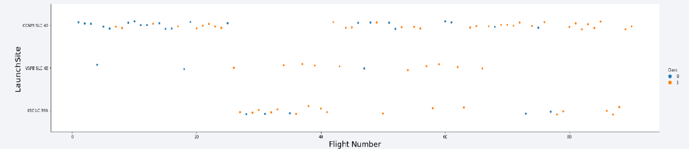
Flight Number vs. Launch Site
By observation, we can see that the successful rate is increasing

Slide 19
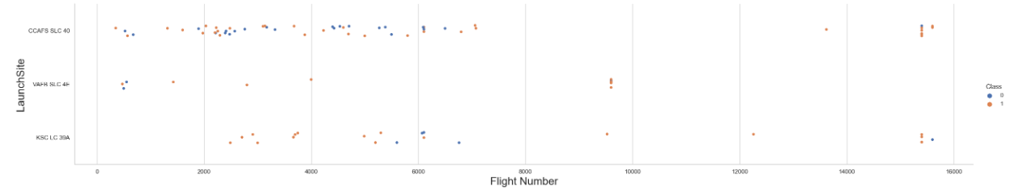
Payload vs. Launch Site
As we can see, Most launches with payload mass under 7,000 kg are from any launch site (Here, these launches have a high success rate), but launches heavier than 12000 kg happens mostly only at CCAFS SLC 40 and KSC LC 39A

Slide 20
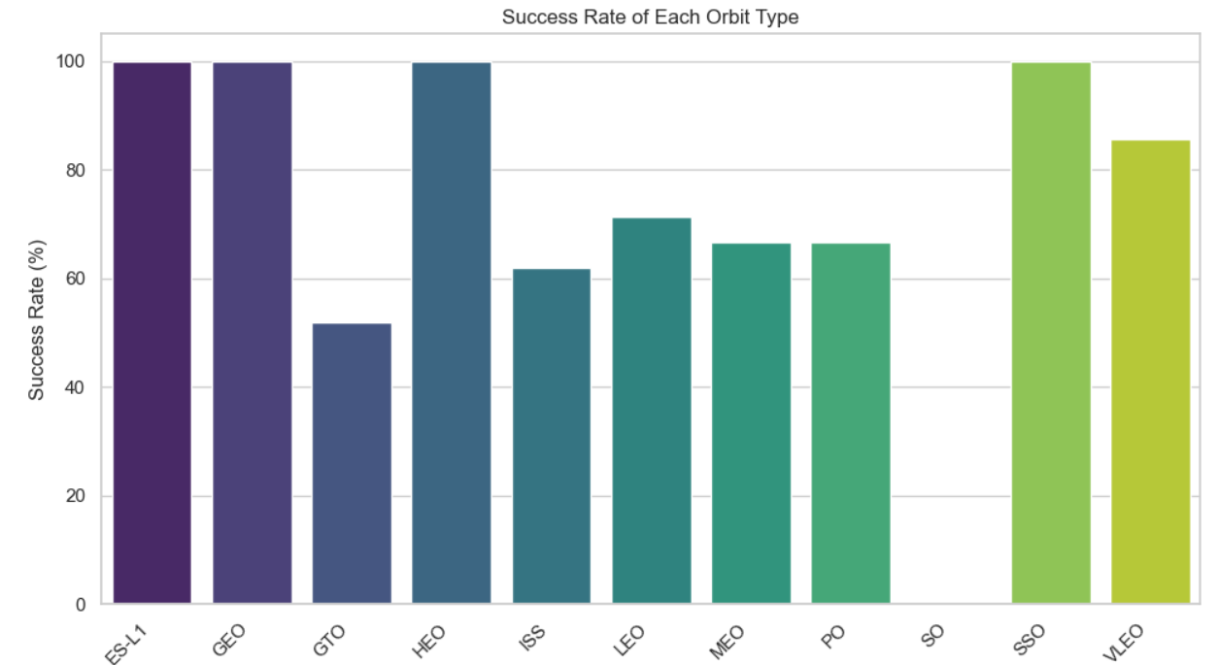
Success Rate vs. Orbit Type
From this diagram, seems like ES-L1, GEO, HEO, SSO have a perfect success rate.

Slide 21
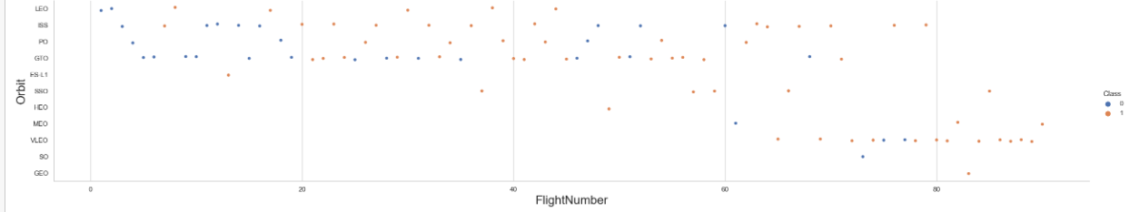
Flight Number vs. Orbit Type
Success rate increases over and over time

Slide 22
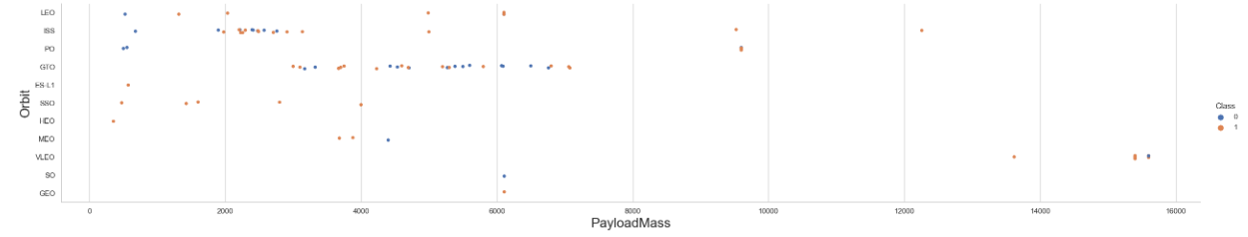
Payload vs. Orbit Type
In conclusion, most successful landing have a lighter payload mass, so a heavier payload mass has a higher probability of failure

Slide 23
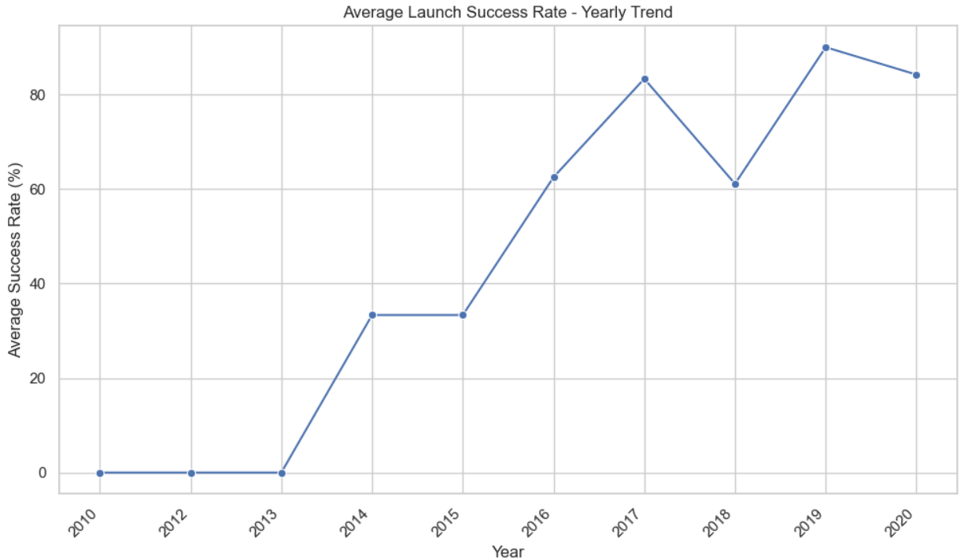
Launch Success Yearly Trend
The overall success rate is increasing since 2013

Slide 24
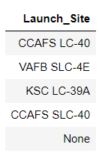
All Launch Site Names
There are four launch site names (shown in the screenshot below, not None)

Slide 25
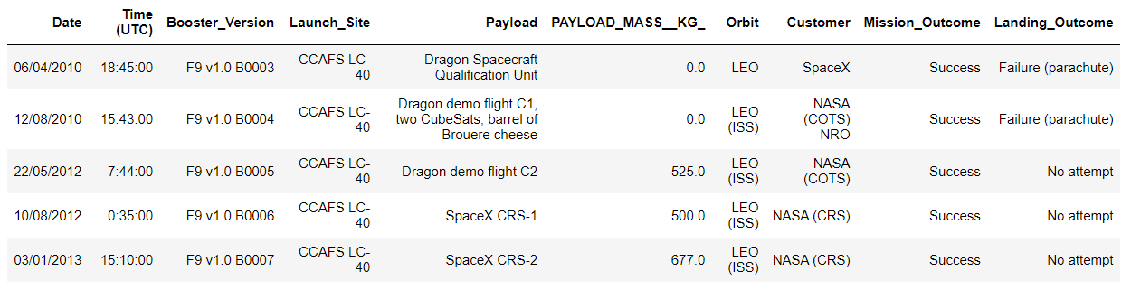
Launch Site Names Begin with 'CCA'
Find 5 records where launch sites begin with `CCA`
Result:

Slide 26
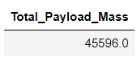
Total Payload Mass
Calculate the total payload carried by boosters from NASA
Result:

Slide 27
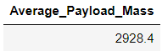
Average Payload Mass by F9 v1.1
Calculate the average payload mass carried by booster version F9 v1.1
Result:

Slide 28
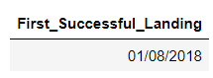
First Successful Ground Landing Date
Find the dates of the first successful landing outcome on ground pad
Result:

Slide 29
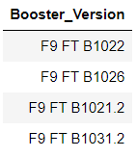
Successful Drone Ship Landing with Payload between 4000 and 6000
List the names of boosters which have successfully landed on drone ship and had payload mass greater than 4000 but less than 6000
Result:

Slide 30
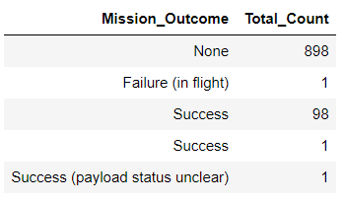
Total Number of Successful and Failure Mission Outcomes
Calculate the total number of successful and failure mission outcomes
Result

Slide 31
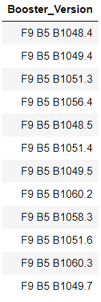
Boosters Carried Maximum Payload
List the names of the booster which have carried the maximum payload mass
Result

Slide 32
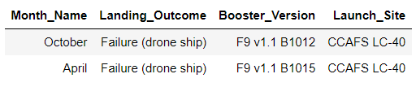
2015 Launch Records
List the failed landing_outcomes in drone ship, their booster versions, and launch site names for in year 2015
Result

Slide 33
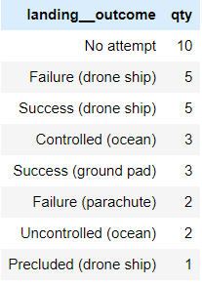
Rank Landing Outcomes Between 2010-06-04 and 2017-03-20
Rank the count of landing outcomes (such as Failure (drone ship) or Success (ground pad)) between the date 2010-06-04 and 2017-03-20, in descending order
Result

Slide 34

Section 3

Slide 35
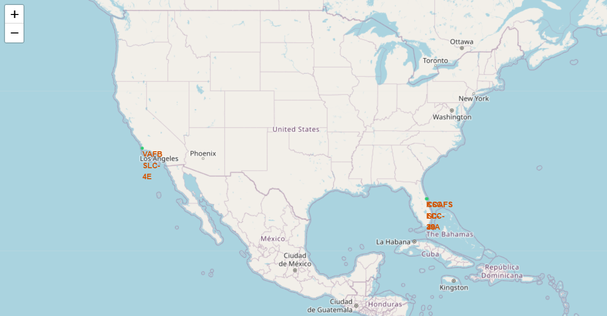
Launch Outcome by Sites
Two areas of launch sites are near center of roads and railways, and they are both in the south area.

Slide 36
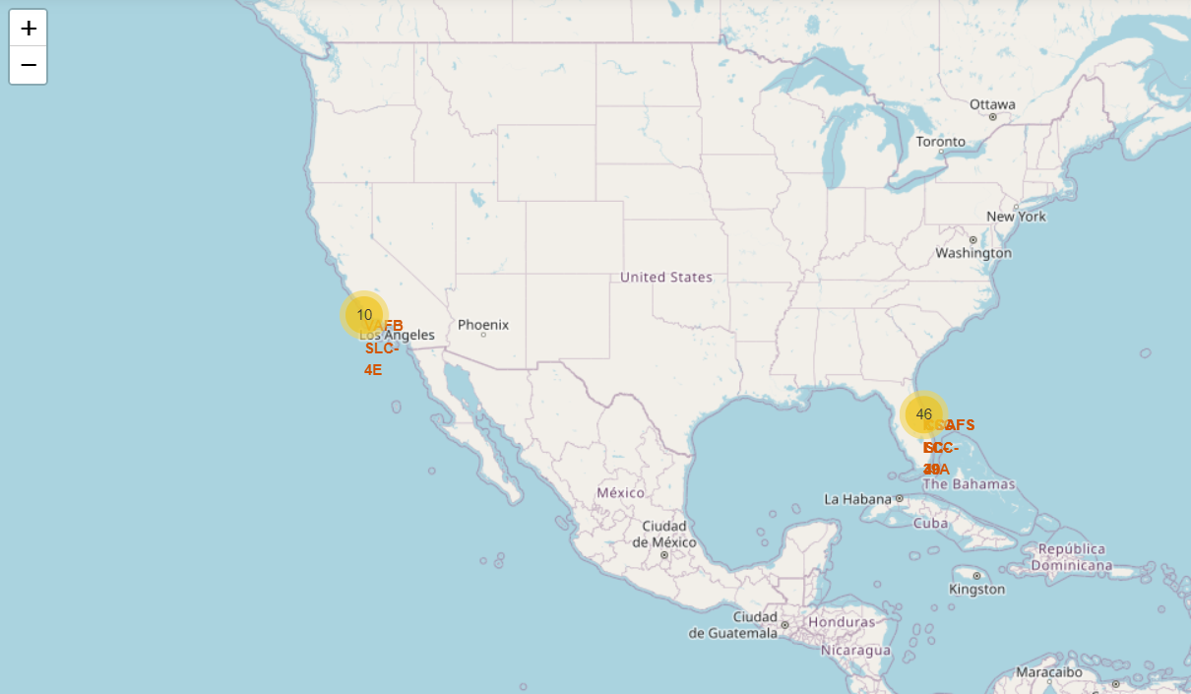
Launch Outcome by Sea
Green one means successful result and rad one means failure

Slide 37
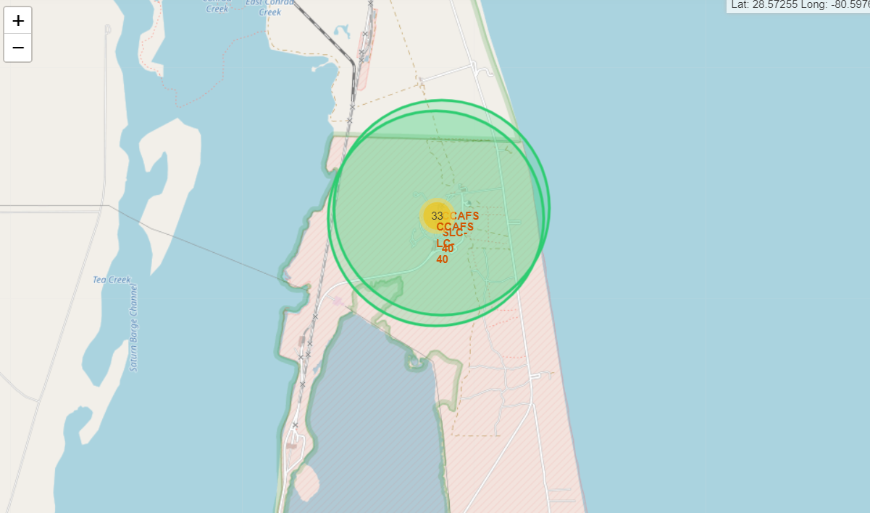
Logistics and Safety
KSC LC-39A is logistic and safe, because it is far away from my populated places.

Slide 38

Section 4

Slide 39
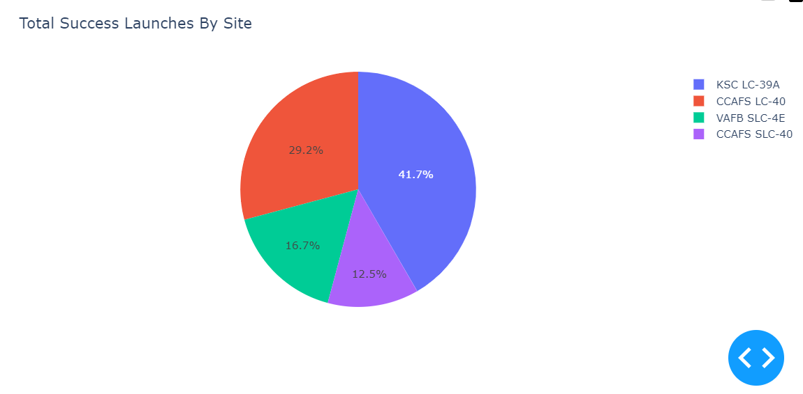
Successful Launches by Site
KSC LC-39A has the most successful launch, 41.7%

Slide 40
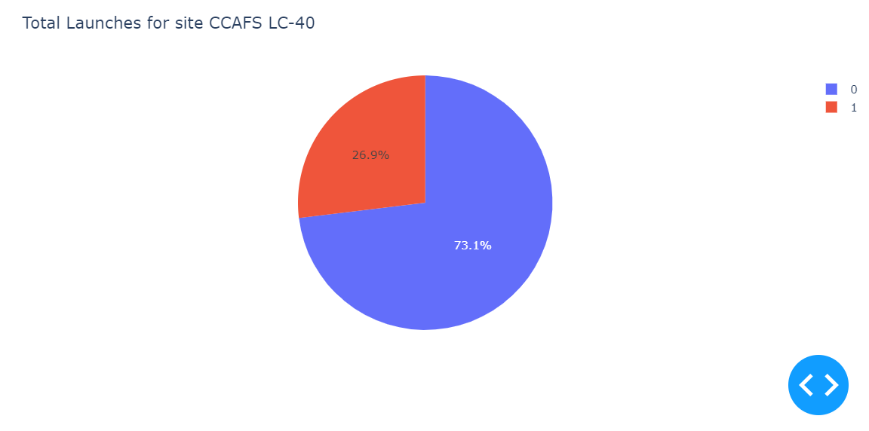
CCAFS LC-40 Launches
Successful rate is 73.1%

Slide 41
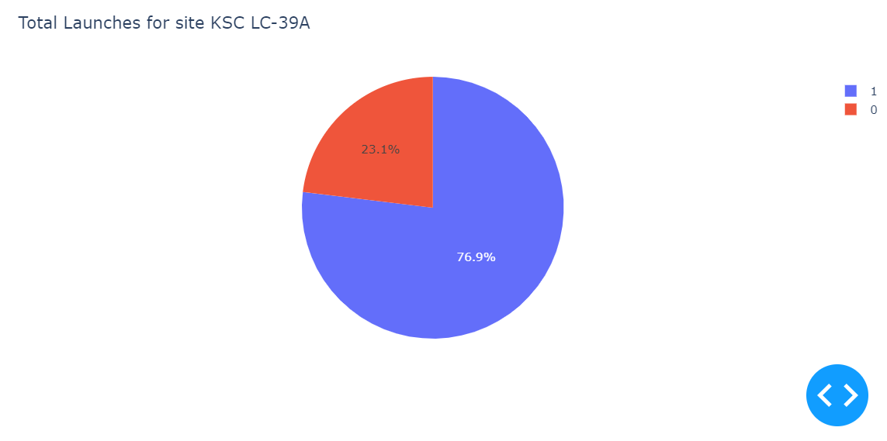
KSC LC-39A Launches
Successful rate: KSC LC-39A -> 76.9%

Slide 42

Section 5

Slide 43
Classification Accuracy
Visualize the built model accuracy for all built classification models, in a bar chart
SVM
Logical Regression
Decision Tree
KNN
Best Performing Model: Logistic Regression
Accuracy on Test Data: 0.8333333333333334

Slide 44
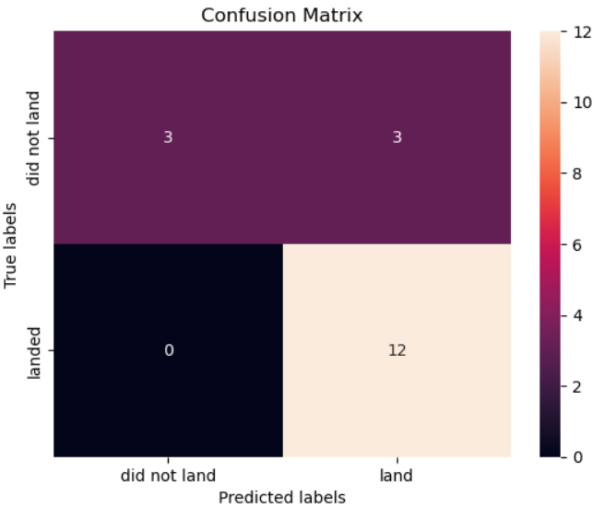
Confusion Matrix
True Positive and False Negative are mostly distributed. So machine learning is accurate.

Slide 45
Conclusions
Logical regression classifier can be used to predict successful landings and reduce costs (This is the optimal choice)
KSC LC-39A has the best result
Launches between 7000 kg and 10000 kg are the most safe.

Slide 46
Appendix
Some notebooks may have inconsistencies, but all questions I have at least one successful result.
I use screenshot inside.

Slide 47


